Slide 1
BASICS OF ROCKETRY AND PARACHUTE DEPLOYMENT

Slide 2
INTRODUCTION
A rocket is a spacecraft, missile, aircraft or other vehicle creating thrust from an engine.
The branch of science that deals with rocket and rocket propulsion is known as rocketry.
The first use of true rockets was in 1232, when Chinese and Mongols were at war. The fire arrows were a simple solid-propellant rocket.

Slide 3
PHYSICS
Rocket works on the principle of Newton’s third law of motion which states that “every action has an equal an opposite reaction”.
Bernoulli’s principle or conservation of energy(higher the speed of the gases, the lower the pressure of gas acting on the combustion chamber).

Slide 4
PROPELLANT
SOLID PROPELLANT
It includes mixture of binder, plasticizer, curing agent, stabilizer.
ADVANTAGE
Easy to store & handle
Compact size & low cost
DISADVANTAGE
Lower specific impulse
LIQUID PROPELLANT
This includes hypergolic and cryogenic propellants.
ADVANTAGE
Higher specific impulse
DISADVANTAGE
Few oxidizers tend to be toxic.
High cost due to elaborate design.
HYBRID PROPELLANT
It usually has a solid fuel and a liquid oxidizer.
ADVANTAGE
Environmentally safe
DISADVANTAGE
Mixing of propellants

Slide 5
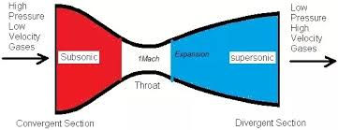
NOZZLE
The function of a nozzle is to convert the chemical thermal energy generated in the combustion chamber to kinetic energy.
It converts high pressure, temperature gas to high velocity gas that has low pressure & temperature.

Slide 6
PARTS OF ROCKET
PAYLOAD
It is the carrying space where the satellites, telescopes, missiles or humans are to be carried.
GUIDANCE SYSTEM
This system ensures that the rocket remains in its trajectory and work where it is intended to work.
It contains onboard system and sophisticated sensor for communication.

Slide 7
PROPULSION SYSTEM
It contains the system to launch the rocket and propel it in a given direction.
It actually works on Newton’s third law. So, more the action by the propulsion system more the reaction.
STRUCTURAL SYSTEM
The frame is similar to fuselage of an airplane.
It has oxidizer tank as well as fuel tank.

Slide 8
ROCKET STAGING
There are 4 kinds of rocket staging:
Serial staging
Parallel staging
Stage-and-a-half
Single staging

Slide 9
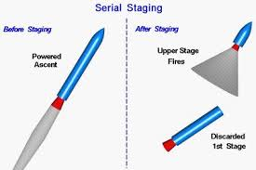
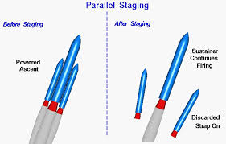

Slide 10
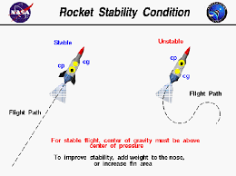
STABILITY
CG is the point around which the rocket turns.
CP is the point where cumulative pressure of wind appears to be pushing against.
If CG is in front of CP, rocket is stable.

Slide 11
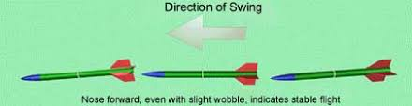
SWING TEST
The swing test provides rough idea of how the rocket will fly.
If the rocket points in the direction to the direction we swing, the rocket is stable.

Slide 12
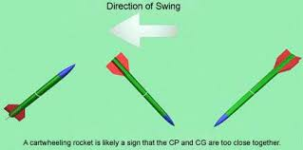
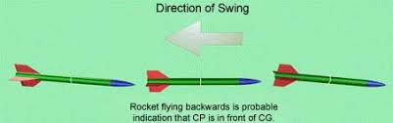
If the CP and CG are too close together then the rocket will cartwheel as we swing it.
When CP is in front of CG the rocket flies backwards.

Slide 13
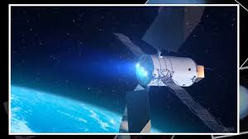
ROCKET TYPES
ION ROCKET
It uses electrical energy from solar cells to provide thrust.
It propels xenon ions, whose negative electrons are stripped by rocket’s electron gun.

Slide 14
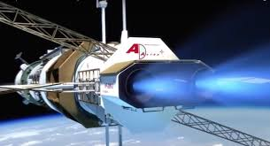
PLASMA ROCKET
VASMIR(Variable Specific Impulse Magnetoplasma Rocket), works by accelerating plasma produced by stripping negative electrons from hydrogen atoms inside a magnetic field.

Slide 15
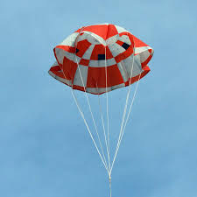
PARACHUTE DEPLOYMENT

Slide 16
Deployment of parachute is defined as the process of extending the parachute canopy and suspension lines to a position at which inflation can occur.

Slide 17
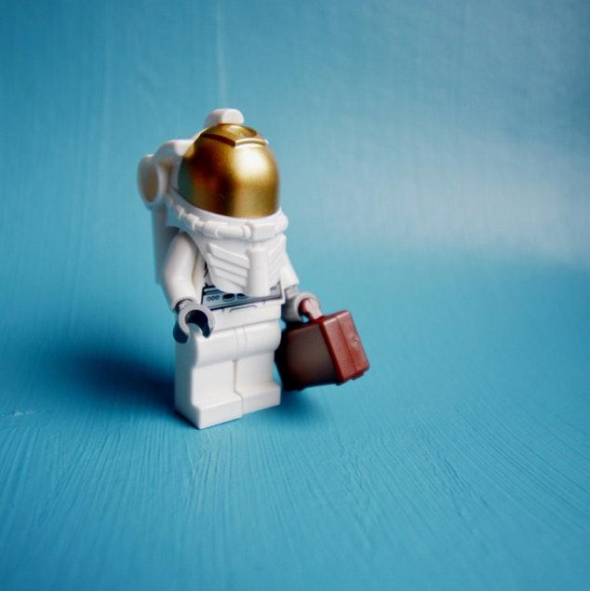
So, more the spread of canopy and suspension lines, more will be the inflation.

Slide 18
IDEA

Slide 19
So, in order to have a safe landing of the rocket there should be some limitations such as
The weight of payload
Much area for the parachute inside the rocket
Additional parachute to evacuate from any mishappenings.

Slide 20
How rockets propel in outer space where there is no air?
We can think of an explosion inside a box that is open at the bottom.
An explosion is a rapid expansion of compressed gas which pushes the box apart evenly in all directions.
Here the box is not balanced by any force against the bottom.

Slide 21
The result is the box flies in the air because of the force of expanding gas on the top.
A rocket engine is like a box which is a continuous series of explosions going off inside it.

Slide 22
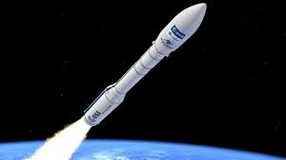
Air actually makes the rocket less efficient because of the drag it imparts, especially at the speeds, a rocket can travel.

Slide 23
CONCLUSION
At last, we conclude that rockets are not just spacecrafts but they are the very instruments that can help us to dive more in the field of space science and explore new things and help us in near future.

Slide 24
Thanks!
ANY QUESTIONS?

